Slide 1

Cloud Computing and Distributed Systems
Week-8
Mayank Taneja,
Teaching Assistant

Slide 2
Q. 1 Identify the correct Kafka commands for the following:
P: These are the commands of your Unix pipelines. Use it to transform data stored in Kafka.
Q: It is the I/O redirection in your Unix pipelines. Use it to get your data into and out of Kafka.
R: It is the distributed, durable equivalent of Unix pipes. Use it to connect and compose your large-scale data applications.
A. P: Kafka Streams, Q: Kafka Connect, R: Kafka Core
B. P: Kafka Core, Q: Kafka Connect, R: Kafka Stream
C. P: Kafka Streams, Q: Kafka Core, R: Kafka Connect
D. P: Kafka Core, Q: Kafka Streams, R: Kafka Connect

Slide 3
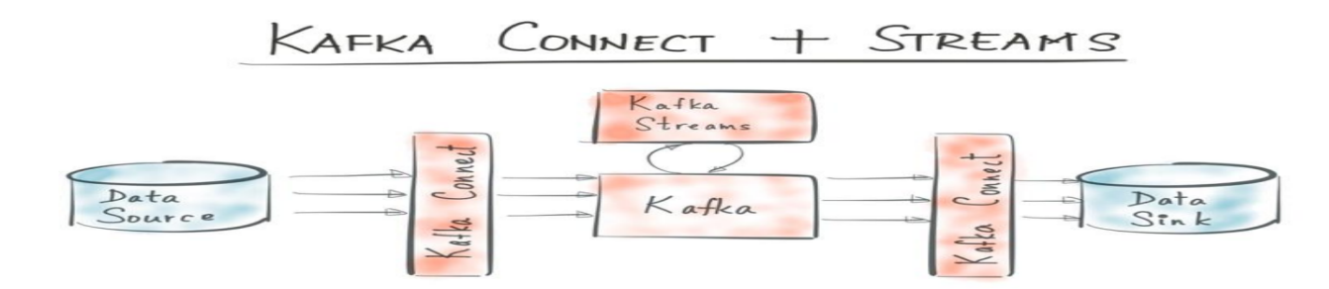
Apache Kafka
Apache Kafka is an open source streaming data platform with 3 major components:
Kafka Core: A central hub to transport and store event streams in real-time.
Kafka Connect: A framework to import event streams from other source data systems into Kafka and export event streams from Kafka to destination data systems.
Kafka Streams: A Java library to process event streams live as they occur.

Slide 4
Pipes in Linux
The Pipe is a command in Linux that lets you use two or more commands such that output of one command serves as input to the next. In short, the output of each process directly as input to the next one like a pipeline. The symbol ‘|’ denotes a pipe.
For eg: cat filename | less
Kafka Core
Kafka Core is the distributed, durable equivalent of Unix pipes. Just like pipes redirect output of one command to serve as input to another, it redirects output from one Kafka connect to serve as input to another Kafka Connect

Slide 5
Linux I/O Redirection
Redirection can be defined as changing the way from where commands read input to where commands sends output. You can redirect input and output of a command. Angle brackets( '<' and '>') are used for i/o redirection
For eg: cat > filename.txt
Kafka Connect
Kafka Connect is the I/O redirection in your Unix pipelines. Use it to get your data into and out of Kafka.

Slide 6
Like Linux commands for eg: cat, grep, touch etc. transform the data in local machine.
Kafka Streams are the commands of your Unix pipelines. Use it to transform data stored in Kafka.

Slide 7
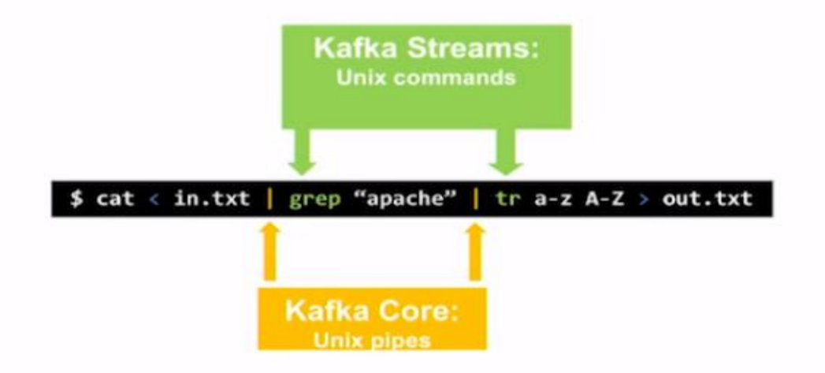

Slide 8
Q2. Choose the correct items for X, Y, and Z.
X can create a Y by sharing information between each other directly or indirectly using Zookeeper. A Y has exactly one broker that acts as the Z.
A. X- Kafka cluster, Y- Kafka broker , Z- Master
B. X- Zookeeper, Y- Kafka cluster , Z- Slave
C. X- Zookeeper, Y- Kafka broker , Z- Controller
D. X- Kafka broker, Y- Kafka cluster , Z- Controller

Slide 9
Kafka Data Model
The Kafka data model consists of messages and topics.
Messages represent information such as, lines in a log file, a row of stock market data, or an error message from a system.
Messages are grouped into categories called topics. Example: LogMessage and Stock Message.
The processes that publish messages into a topic in Kafka are known as producers.
The processes that receive the messages from a topic in Kafka are known as consumers.
The processes or servers within Kafka that process the messages are known as brokers.

Slide 10
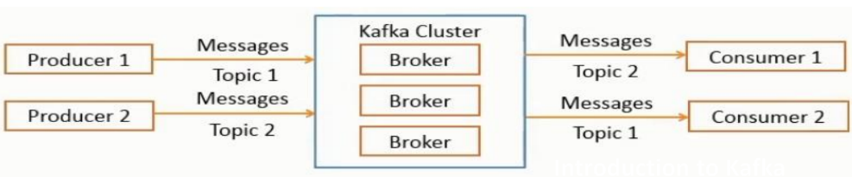
A Kafka cluster consists of a set of brokers that process the messages.

Slide 11
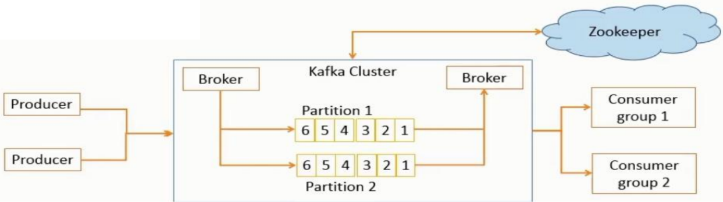
A Kafka broker allows consumers to fetch messages by topic, partition and offset.
Kafka broker can create a Kafka cluster by sharing information between each other directly or indirectly using Zookeeper.
A Kafka cluster has exactly one broker that acts as the Controller.

Slide 12
Q. 3 True or False ?
A topic is a category or feed name to which messages are published. For each topic, the Kafka cluster maintains a partitioned log
A. True
B. False

Slide 13
Topics
A topic is a category of messages in Kafka.
The producers publish the messages into topics.
The consumers read the messages from topics.
A topic is divided into one or more partitions, which is also known as a commit log.
Each partition contains an ordered set of messages.
Each message is identified by its offset in the partition.
Messages are added at one end of the partition and consumed at the other.

Slide 14
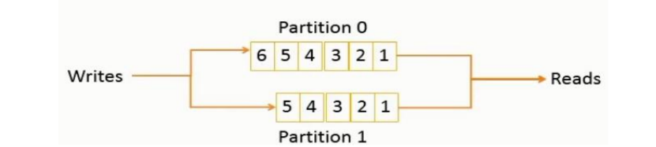
Partitions
Topics are divided into partitions, which are the unit of parallelism in Kafka.
Partitions allow messages in a topic to be distributed to multiple servers.
A topic can have any number of partitions.
Each partition should fit in a single Kafka server.
The number of partitions decide the parallelism of the topic.

Slide 15
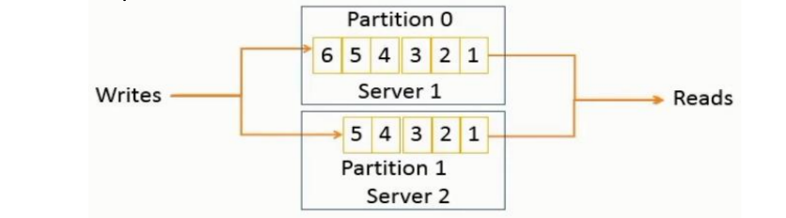
Partition Distribution
Partitions can be distributed across the Kafka cluster.
Each Kafka server may handle one or more partitions.
A partition can be replicated across several servers for fault-tolerance.
One server is marked as a leader for the partition and the others are marked as followers.
The leader controls the read and write for the partition, whereas, the followers replicate the data.
If a leader fails, one of the followers automatically become the leader.
Zookeeper is used for the leader selection.

Slide 16
Q. 4 Each partition has one server which acts as the "leader" and zero or more
servers which act as_______________
A. Leader
B. Followers
C. Stater
D. None of the mentioned

Slide 17
Answer: B) Followers
Explanation: Each partition has one server which acts as the "leader" and zero or
more servers which act as "followers". The leader handles all read and write
requests for the partition while the followers passively replicate the leader. If the
leader fails, one of the followers will automatically become the new leader. Each
server acts as a leader for some of its partitions and a follower for others so load
is well balanced within the cluster.

Slide 18
Q. 5 _________________________ is a fundamental data structure of Spark. It is
an immutable distributed collection of objects.
A. Spark Streaming
B. Resilient Distributed Dataset (RDD)
C. FlatMap
D. Driver

Slide 19
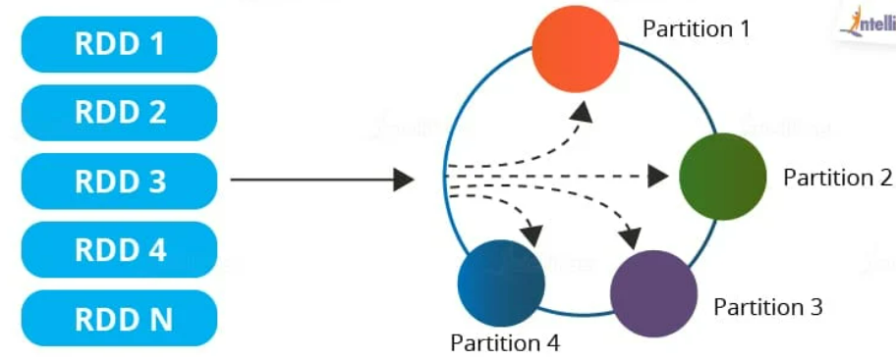
Resilient Distributed Datasets (RDDs)
RDDs are the main logical data units in Spark. They are a distributed collection of objects, which are stored in memory or on disks of different machines of a cluster. A single RDD can be divided into multiple logical partitions so that these partitions can be stored and processed on different machines of a cluster.
RDDs are immutable (read-only) in nature. You cannot change an original RDD, but you can create new RDDs by performing coarse-grain operations, like transformations, on an existing RDD.
An RDD in Spark can be cached and used again for future transformations, which is a huge benefit for users. RDDs are said to be lazily evaluated, i.e., they delay the evaluation until it is really needed. This saves a lot of time and improves efficiency.

Slide 20
Features of an RDD in Spark
Resilience: RDDs track data lineage information to recover lost data, automatically on failure. It is also called fault tolerance.
Distributed: Data present in an RDD resides on multiple nodes. It is distributed across different nodes of a cluster.
Lazy evaluation: Data does not get loaded in an RDD even if you define it. Transformations are actually computed when you call action, such as count or collect, or save the output to a file system
Immutability: Data stored in an RDD is in the read-only mode━you cannot edit the data which is present in the RDD. But, you can create new RDDs by performing transformations on the existing RDDs.
In-memory computation: An RDD stores any immediate data that is generated in the memory (RAM) than on the disk so that it provides faster access.
Partitioning: Partitions can be done on any existing RDD to create logical parts that are mutable. You can achieve this by applying transformations to the existing partitions.

Slide 21
Q. 6 Which type of processing Apache Spark can handle ?
A. Stream Processing
B. Batch Processing
C. Graph Processing
D. All of the Mentioned

Slide 22
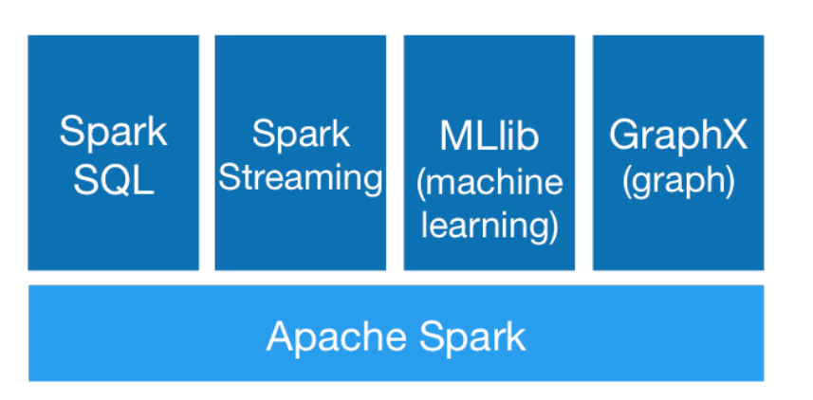
Generality
RDDs allow us generality, which means it allows unification of different programming models
Stream Processing
Graph Processing
Machine Learning …..

Slide 23
Q.7 ______________is a distributed machine learning framework on top of Spark.
Its goal is to make practical machine learning scalable and easy.
A. MLlib
B. Spark Streaming
C. GraphX
D. RDDs

Slide 24
MLLib
MLlib is Spark’s machine learning (ML) library. Its goal is to make practical machine learning scalable and easy. At a high level, it provides tools such as:
ML Algorithms: common learning algorithms such as classification,regression, clustering, and collaborative filtering
Featurization: feature extraction, transformation, dimensionality reduction, and selection
Pipelines: tools for constructing, evaluating, and tuning ML Pipelines
Persistence: saving and load algorithms, models, and Pipelines
Utilities: linear algebra, statistics, data handling, etc.

Slide 25
Q. 8 Which is not a component on the top of Spark Core ?
A. Spark Streaming
B. Spark RDD
C. MLlib
D. None of the mentioned

Slide 26
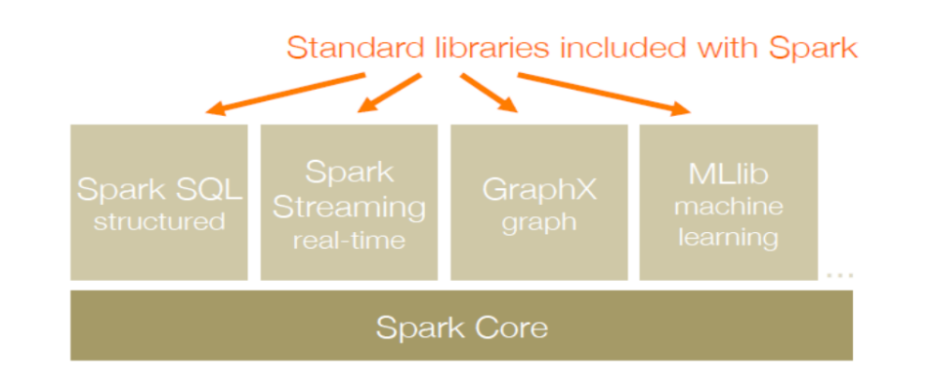
Following are the components on the top of Spark Core

